Slide 1
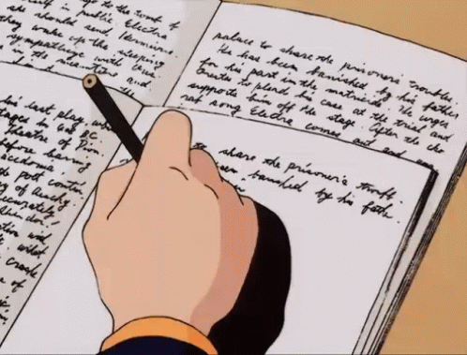
29/04/2026
George Hardwick
How to:
Teach Writing for the B2 Exam

Slide 2

Agenda
Introduction
Pop Quiz
Sample Text & Criteria A
Sample Text & Criteria B
Sample Text & Criteria C
Classroom Activity

Slide 3

Introductions
Discuss with your partner(s):
What experience do you have of teaching writing at the B2 level (& for the FCE exam)?

Slide 4

Pop Quiz!
ANSWERS
Two.
Essay (Part 1, mandatory);
Email or letter / Review / Report (B2 First) / Story (First for Schools) (Part 2, choose between the three)
140-190 words
Four: Content, Communicative Achievement, Organisation, Language
Your opinions!
Work together to answer the questions.

Slide 5
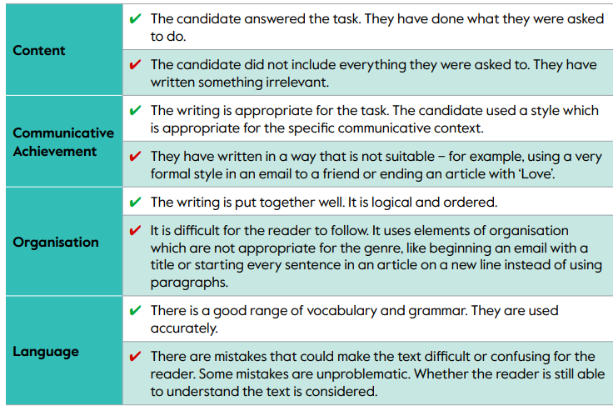
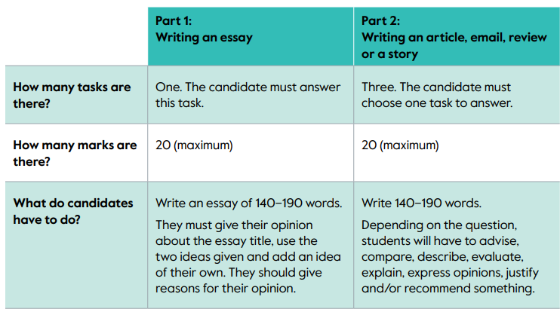
Format & Marking Criteria

Slide 6
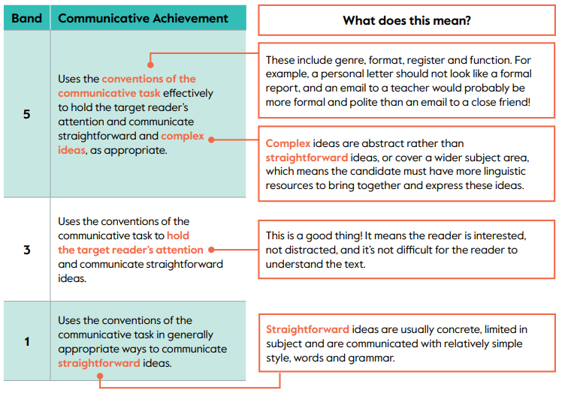
Criteria: Communicative Achievement

Slide 7
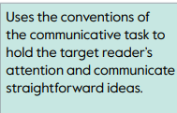
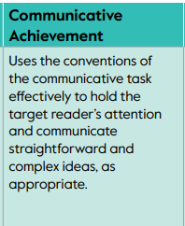
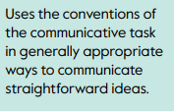
4 or 2 if you think it’s somewhere between 3 & 5 / 1 & 3.
3
5
¹

Slide 8
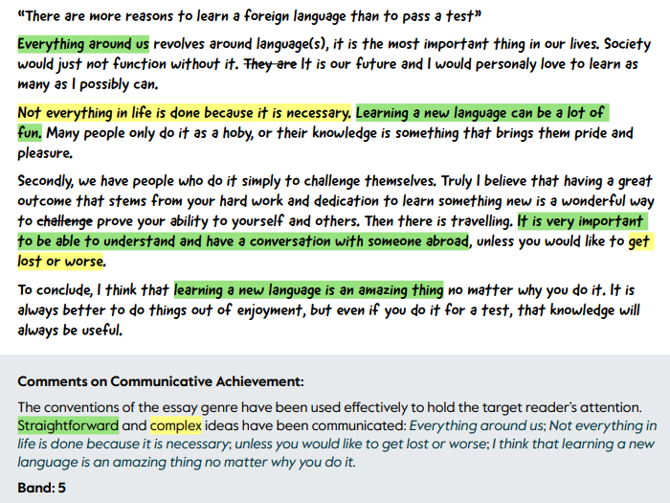
Official Assessment

Slide 9
Teaching…
So - to help our students score highly in Communicative Achievement, what do we need to teach them?

Slide 10
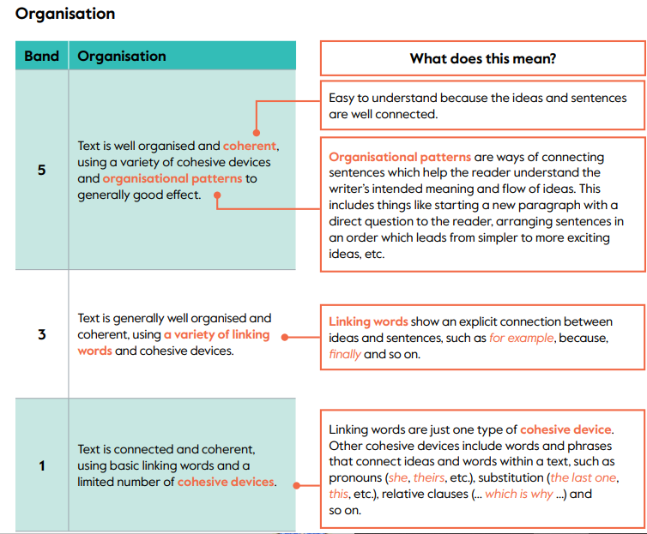
Criteria: Organisation

Slide 11
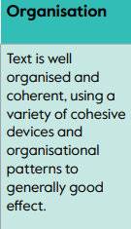
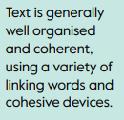
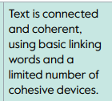
4 or 2 if you think it’s somewhere between 3 & 5 / 1 & 3.
3
5
¹

Slide 12
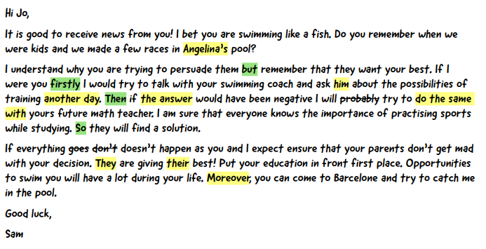
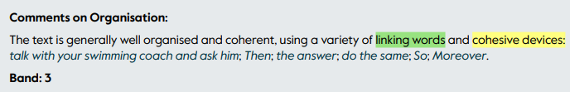
Official Assessment

Slide 13
Teaching…
So - to help our students score highly in Organisation, what do we need to teach them?

Slide 14
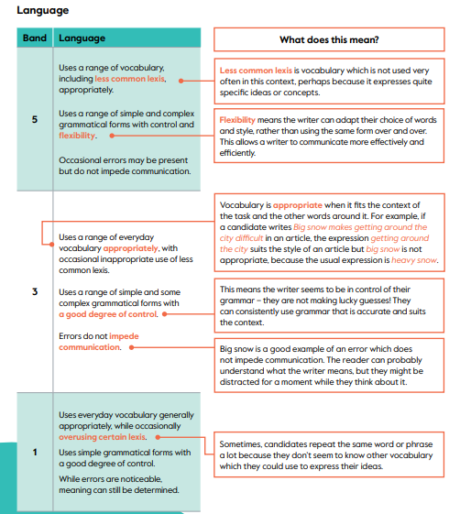
Criteria: Language

Slide 15
4 or 2 if you think it’s somewhere between 3 & 5 / 1 & 3.
3
5
¹

Slide 16
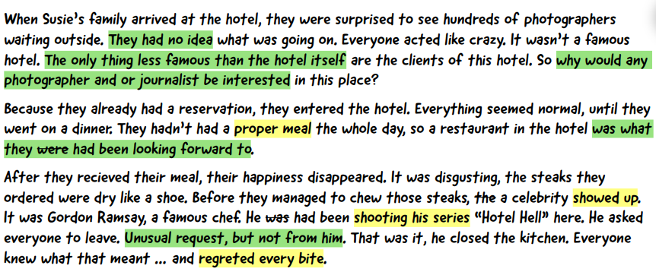
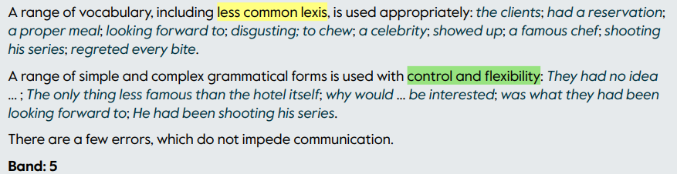
Official Assessment

Slide 17
Teaching…
So - to help our students score highly in Language, what do we need to emphasize and teach?

Slide 18
Rewriting Task
Here is the first draft of a student’s essay.
Read and correct it alone
Re-draft it with a partner(s)
Read other group’s essays and mark them using the FCE Writing Criteria
Reflect: What did you all do to improve the first draft?

Slide 19
Rewriting Task
Here is the first draft of a student’s essay.
Read and correct it alone

Slide 20
Rewriting Task
Here is the first draft of a student’s essay.
2) Re-draft it with a partner(s)

Slide 21
Rewriting Task
3) Read other group’s essays and mark them using the FCE Writing Criteria

Slide 22
First Draft of Essay
Well, I think that my country has problems with pollution to environment like all other countries. This problem is normal for Malaysia. We have big problems with transport because there are too much cars in our country. And because of that we have problems with atmospeer, air in my city and in all Malaysia is really dirty and sometimes I can’t make a sigh because it smells around me and of course around that cars on the road. I’ve heard about tradition of one country. They don’t go anywhere by car one day a month or a year, they just use bycicle or their feet. I think it could be very good if we had a tradition like that.
So, what about the rivers and the seas? Yeah, there are some really good and clean rivers and seas where you can go, but there are not many of them. Once I saw the river in my city, it was about two years ago but I stil remember that in some places it was not blue, it was green or purple I didn’t really understand because it had different colours.
I dunno what should we do. Maybe we should just open our eyes and look what we did. But Malaysian people don’t care about the world around them many people care only about themselves an that’s all.
So, the best idea is look around and try to do something good for our planet and for us and for children.

Slide 23
Rewriting Task
Reflect: What did you all do to improve the first draft?

